Slide 1

Bina Nusantara

Slide 2
ACHROMATIC AND CHROMATIC LIGHT
Calvin Sugianto; Rama Adhitya; Christian; Antonius Surya; Agung Wijayakusuma
05SNT
Universitas Bina Nusantara

Slide 3
ABSTRACT
  Achromatic and Chromatic Light. This presentation slide present a lightning view by achromatic and chromatic based on CIE (International Commission on Illumination Commission International de l’Eclairage) Diagram, the problem of our perspective to the image of the lightning based on the color definition will be solved by a program that we made by OpenGL that created by Microsoft Foundation in purpose to stimulate our conception in lightning by some view and by different intentsity of lightning.

Slide 4
Preface
Achromatic Light
This is colorless light described by the notions black-gray white. Its main quality is INTENSITY or LUMINANCE, which is the quantity of light in the physics sense of energy. In contrast BRIGHTNESS is the perceived intensity in the psychological sense.
Bina Nusantara

Slide 5
Achromatic Light
Achromatic light runs the gamut from black through grays to white light. The quantity of light is
the only attribute of achromatic light. Physicists talk of intensity or luminance of the light energy.
Psychologists talk of the brightness of the perceived intensity. Luminance and brightness are related
by not identical concepts. We'll scale these quantities so that
Zero (0) is dened as black. One (1) is dened as white.
Gray is any value between 0 and 1.
Gray scale display devices can produce values 0, 1, and some discrete subset between 0 and 1.
Monochrome or bi-level display devices produce only black and white images.
Bina Nusantara

Slide 6
Preface
Gamma Correction
What is the relationship between intensity and brightness? Let us scale brightness and intensity in such a way that 1.0 is assigned to the maximal value. For a monitor it is clear what is meant by maximal value; on the other hand there is a minimal intensity we denote . Note that , i.e. absolute black is not possible, since the phosphors in the CRT (Cathode Ray Tube) reflect light. The proportion is called the DYNAMICAL RANGE of the monitor and is for CRTs usually typically 50 and 200.
Bina Nusantara

Slide 7
Gamma Correction
2.1.1 Gamma Correction of Cathode Ray Tubes (CRTs)
The eye is sensitive to ratios of intensity levels rather than absolute intensity. For example, weperceive changes in intensity from 0.1 to 0.11 as equal to a change in intensity from 0.5 to 0.55. Theratios are equal: 0.11:0.1 = 0.55:0.5. One the other hand, when we switch a three way bulb from 50to 100 to 150 watts, our perception of the change in intensity is not identical: Switching from o to 50 watts is an innite increase in brightness, while Switching to 50 from 100 seems to give is less ofn increase and the change from 10 to 150 watts is even less of an increase in brightness. These arephysiological phenomena.
What does this mean for computer graphics? We'll suppose that you had a gray scale devicewith settings of 0, 1/4, 1/2, 3/4, and 1. If these values corresponded exactly to the intensity orbrightness of the display we would not perceive them as uniform changes in brightness. The ratiosof consecutive values: 1, 2, 3/2, and 4/3 are not uniform. We need to \correct" the values to obtainuniform ratios for uniform gray levels.
Bina Nusantara

Slide 8
2.1.1 Gamma Correction of Cathode Ray Tubes (CRTs) continiue
Good modern graphics monitors will compensate for our non-linear perception of intensity changes by gamma correction. For those that don't we should implement gamma correction insoftware. Here's how it works.
To select n+1 intensities I0; I1; : : : ; In between 0 and 1 so that they have equal steps in brightness(perceived intensity) we'll _nd a _xed ratio r such that r = Ij+1=Ij for all j = 0; 1; : : : ; n􀀀1. That is, I0 = I0; I1 = rI0; I2 = rI1 = r2I0; : : : ; In = rIn􀀀1 = rnI0 = 1:
Using the last setting rnI0 = 1, we _ndr = (1=I0)1=(n) And Ij = rj I0 = I(n􀀀j)=(n)0 ; j = 1; : : : ; n:
The lowest intensity level depends on the display. Typical values for I0 are between 0.005 and 0.025. Notice that perfect black is not possible. The dynamic range of a CRT is the ratio between maximum and minimum intensities, that is the dynamic range is In=I0 = 1=I0. The display of an intensity Ij is still tricky. Given that there are N electrons in a beam hitting a phosphor, the intensity of light output is determined by the formula I = kN;
Bina Nusantara

Slide 9


Preface
Since on the computer we can only code a finite number of levels inbetween and 1, we have to decide for which intensity levels they should stand for. Linear spacing like
for some increment is not a good idea, since the eye is sensitive to ratios of intensity levels rather than absolute values of intensity. Thus we should space intensity levels logarithmically, i.e.
Bina Nusantara

Slide 10
Preface
For some factor . For a dynamical range of say and steps (as they can be coded by one byte in the range 0...FF) we obtain the factor corresponding to a intensity increase for each step. The approximate intensity increase the human eye can detect is about , i.e. . So we need many steps to display a continuous scale from to on a display with a dynamical range of .
Bina Nusantara

Slide 11
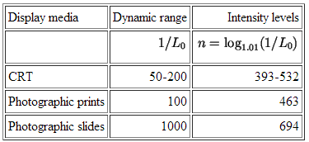
Preface
Consequently, coding gray values using one byte(=8 bits) per pixel is not enough to ensure a continuous gray scale. In practice for B&W printing slight blurring due to ink bleeding and random noise reduces the number of distinguishable intensities to approximately 64.
Bina Nusantara

Slide 12
Preface
Halftone Approximation
If we cannot display all the required intensity levels (e.g. on a printer) we need a trick using the spatial integration that our eyes performs: In normal light the eye can only detect about one arc minute ( degree). This is called VISUAL ACUITY. Thus instead of gray dots a small black disk with radius varying according to the blackness is printed. Usually, for newspaper 60-80 and for magazines 150-200 different radiuses are used. This process is called HALFTONING.
Bina Nusantara

Slide 13
Halftone Approximation
Halftoning is a method used to represent shades of gray on a strictly monochrome (black and white)device, for example, black and white newspaper photographs are halftone images that appear to have shades of gray. The idea is to use multiple pixels (dots) to represent a single pixel (dot).
Suppose an image has fewer pixels than the device on which it will be displayed. Then perceived intensity range of the image can be increased, at a cost of reduced spatial resolution, by halftoning or clustered-dot ordered dithering, which uses variable sized black circles to produce dierent intensitylevels. Graphics devices can approximate variable-area circles. For example, with a 2 2 grid, 5dierent intensity levels can be achieved, as shown in figure 1

Slide 14
Halftoning continue
There are several guidelines for selecting the set of patterns for halftoning. Most of them are subjective.
Avoid patterns that will introduce visual artifact, eg. horizontal, vertical, or diagonal line, in the image
Form a growth sequence with the patterns | any pixel intensied at level j is intensied at level k for k > j
Grow the patterns outward from the center, to create eect of increasing dot size
For devices that can't plot isolated dots well, eg. laser printers, all \on" pixels should be adjacent
Bina Nusantara

Slide 15
Chromatic Light
Color perception involves three attributes: hue,saturation, and lightness. Hue or chromaticity classies the quality of the color as determined by its dominant wavelength. You use color names such as red, yellow, orange, green, cyan, blue, magenta,etc., to specify a hue. Saturation or chroma is the degree of dierence from the achromatic light of the same brightness. It is the chromatic purity: freedom from dilution with white and hence vividnessf hue. A saturated color is a pure spectral color, an unsaturated color is pastel. Lightness is the perceived intensity of a reecting object, while brightness is the perceived intensity of a self-luminous object.
Bina Nusantara

Slide 16
Colorimetry is a branch of physics which provides an objective, quantitative way of measuringcolor. The basics include measurements of:
dominant wavelength of light: This corresponds to the perceptual notion of hue.
excitation purity of light: This corresponds to saturation.
luminance measures intensity or energy of light: This corresponds to lightness or brightness.
Light can also be described by frequency f which is related to wavelength by
f =c/lamda
Bina Nusantara

Slide 17

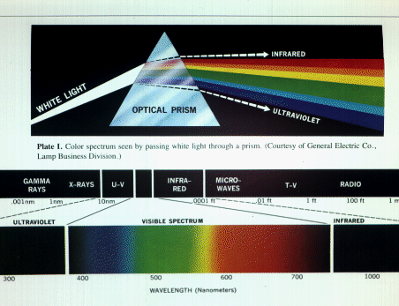
The visible spectrum.
Bina Nusantara

Slide 18
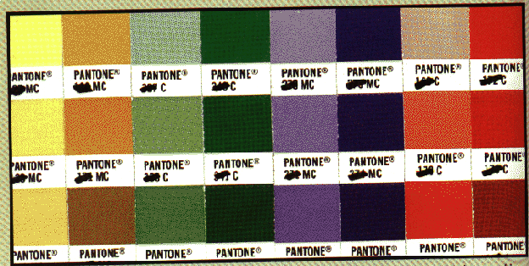
Preface
Chromatic Light
How to describe color? - We have several possibilities:
1. Make a table of colors, e.g. Munsell color-order system.
Figure: A commercial color table
Bina Nusantara

Slide 19

Preface
2. Assign names to colors, e.g. Light-Goldenrot-Yellow, Medium-Spring-Green, etc.
3. Produce colors by some process: Artists speak about the following variations of pure pigments:
TINTS (means adding white),
SHADES (means adding black),
and TONES (means adding a combination of both).
Figure: The artists description of colors
Bina Nusantara

Slide 20
Preface
Consequently colored light has following quantities associated:
HUE (corresponding to pure pigment)
SATURATION (i.e. distance from gray of equal intensity)
LIGHTNESS (i.e. perceived intensity of a reflecting object)
or BRIGHTNESS (i.e. perceived intensity of light emitting object).
Bina Nusantara

Slide 21
Preface
Psychophysics
Colorimetry:
Light is ELECTROMAGNETIC ENERGY in the 400nm to 700nm wavelength, where one nm (nanometer) is mm. Pure or MONOCHROMATIC LIGHT is perceived as one color in the range violet-indigo-blue-green-yellow-orange-red of the rainbow.
Bina Nusantara

Slide 22
Preface
Many different distributions produce the same color impression (and are called METAMERS). Thus one can quantify light by:
DOMINANT WAVELENGTH (color we see), which corresponds to hue,
EXCITATION PURITY (proportion of pure light of dominant wavelength to white light), which corresponds to saturation, and
Bina Nusantara

Slide 23
Preface
LUMINANCE which corresponds to intensity.
Note however, that the dominant wavelength is not necessarily that with largest spectral component.How is color determined by the human eye? The retina seems to have 3 kind of color sensors (called CONES) with approximative peak sensitivity at red, green and blue. This is the TRI-STIMULUS THEORY of color perception.
Bina Nusantara

Slide 24
The tristimulus theory
The human visual system plays an integral part in the theory of color. Within the human eye are two element which are responsible for the perception of light. These are the rods and cones. The rods contain the elements that are sensitive to light intensities. They are used almost exclusively at night for humans night vision. The cones provide humans with vision during the daylight and are believed to separated into three types, where each type is more sensitive to a particular wavelength.
The perception of color by the human visual system is based on the tristimulus theory, which states that color vision results from the action of three types of cone receptor mechanisms with dierent spectral sensitives. When light of a particular wavelength is presented to the eye, these mechanisms are stimulated to dierent degrees, and the ratio of activity in the three mechanisms results in the perception of a color. Each color is therefore, coded in the nervous system by its own ratio of activity in the three receptor mechanism.
Bina Nusantara

Slide 25
The tristimulus theory con…
Experiments have produced spectral-response functions which show:
blue has peak response around 440 nm, with about 2% of light absorbed by the blue cones;
green has peak response around 545 nm, with about 20% of light absorbed by the green cones;
red has peak response around 580 nm, with about 19% of light absorbed by the red cones;
the eye's response to blue light is much less strong than it is to green or red;
Bina Nusantara

Slide 26
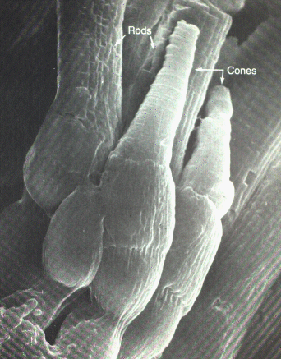
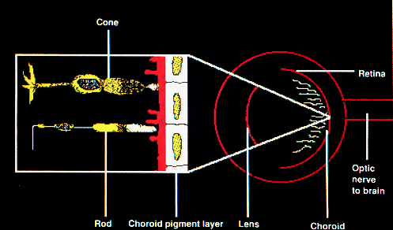
Photograph of rods and cones. A schematic of rods and cones.
Bina Nusantara

Slide 27
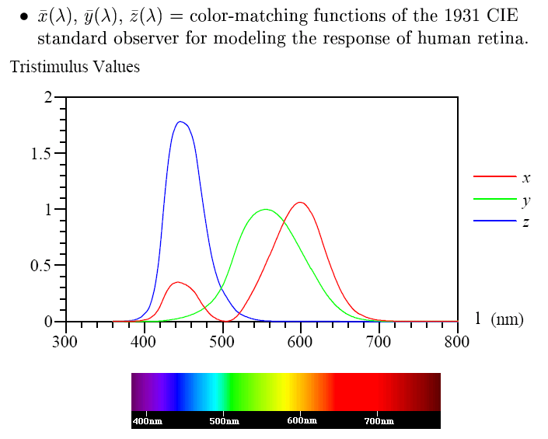
CIE Tristimulus Model
Bina Nusantara

Slide 28
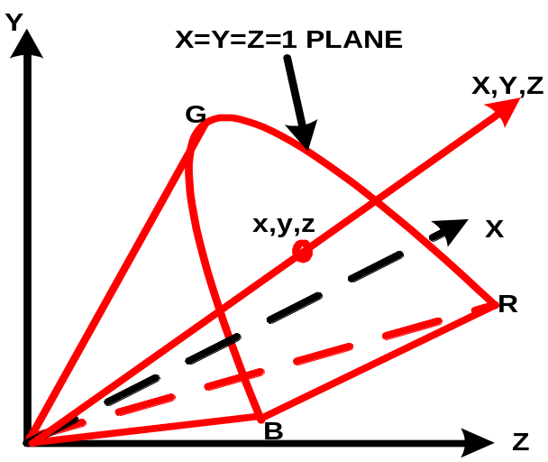
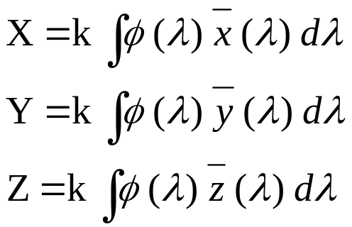
CIE Tristimulus Model
CIE:
  International Commission on Illumination (Commission International de l’Eclairage)
A standardized method of specifying a color by three values X, Y, Z i.e :
φ(λ)= S(λ), the relative spectral power of the illuminant
For a reflecting material, φ(λ)= S(λ) R (λ) where R (λ) is the reflection factor of the material
Bina Nusantara

Slide 29
Color matching
Imagine viewing a test color with the left eye and having 3 knobs to control the red, green, and blue components of a second color, seen with the right eye. Pretend you can turn the knobs turn in 1nm increments. You are directed to turn the knobs until you agree the color seen with the right eye matches the test color seen with the left eye.
As the test color's dominant wavelength is varied, three color matching functions, r, g, and b, are recorded to show the amount of red, green, and blue needed to match the test color. For some test colors, the values of r, g, or b may be negative! Which is not possible (we can't suckup light). But we can move the appropriate red, green, or blue light to the test color side. Thus, it has been found that not all colors can be represented by positive RGB mixes.
Bina Nusantara

Slide 30
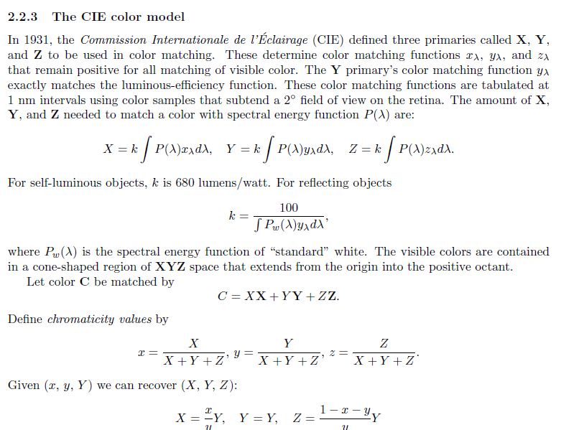
Bina Nusantara

Slide 31
The RGB color model
The red, green, and blue (RGB) color model is used for color CRT monitors. The model is represented by a unit cube, where red, green, and blue are at corners (1; 0; 0), (0; 1; 0), and (0; 0; 1), see gure 8. Black is at (0; 0; 0) with grays along the diagonal to white at (1; 1; 1).
The RGB primaries (red, green, and blue) are additive. That is new colors are formed by adding red, green, and blue. Cyan (0; 1; 1) is formed by adding green and blue; magenta (1; 0; 1) is formed by adding red and blue; yellow (1; 1; 0) is formed by adding red and green. Red and cyan are complementary; green and magenta are complementary; blue and yellow are complementary.
Bina Nusantara

Slide 32

The RGB color model
The transformation from RGB to CIE is given by
Bina Nusantara

Slide 33
The CMY color model
Cyan, magenta, and yellow are used with hardcopy devices that deposit colored pigment onto paper.The CMY model describes this subtractive process for primaries cyan, magenta, and yellow. Cyan subtract (lters) red from reected white light allowing only green and blue to be be seen. Magenta absorbs green; yellow absorbs blue. The CMY model uses a unit cube just as RGB does only with a relabeling of corners, cyan is at (1; 0; 0), magenta is at (0; 1; 0), and yellow is at (0; 0; 1).
Bina Nusantara

Slide 34
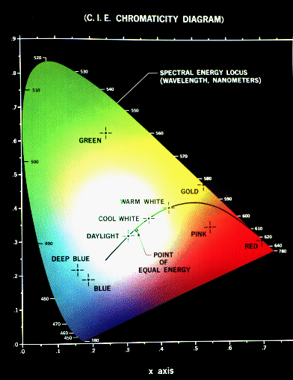
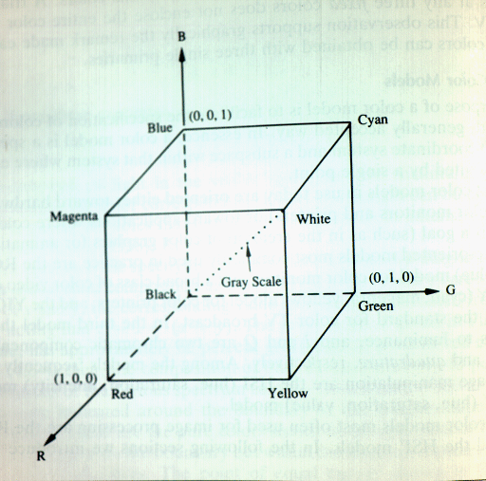
The CIE diagram and RGB color cube.
Bina Nusantara

Slide 35
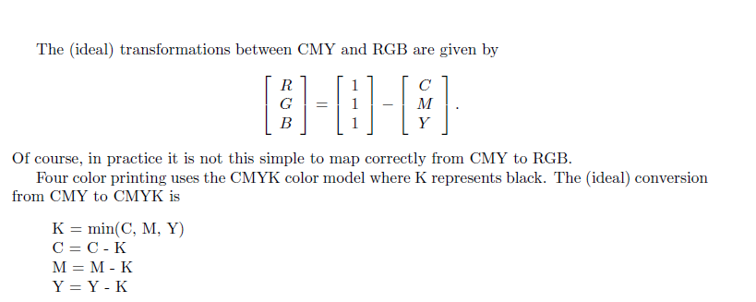
Continue
Bina Nusantara

Slide 36
HSV Color Model
The Hue, Saturation, and Value (HSV) color system is closer to the artist's model of color mixing.
The model is defined on a hexcone, or six-sided pyramid.
The top of the cone, given by V=1, contains the brightest colors.
The apex of the cone corresponds to black.
Hue is measured by angles around the cone's vertical axis (Red , Green , Blue ).
Bina Nusantara

Slide 37
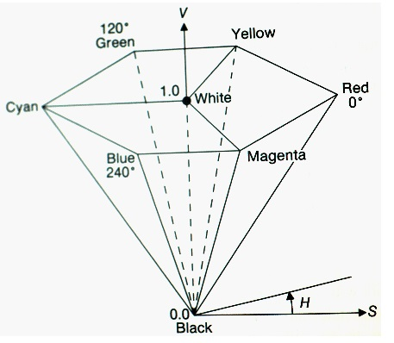
HSV Color Model
Bina Nusantara

Slide 38
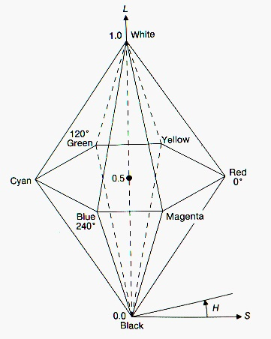
The HLS color model
The hue, lightness, and saturation (HLS) color model uses a double hexcone.
White is at L=1 and black is at L=0.
Hues are measured in angles from 0 to 360 degree.
Saturation varies from 0 on the L axis to 1 on the face of the cone
Bina Nusantara

Slide 39
Guideline For Using Color (1)
1. Select colors by some method,
2. Avoid the simultaneous display of highly saturated, spectrally extreme colors.
3. Pure blue should be avoided for text, thin lines, and small shapes.
4. Avoid adjacent colors that differ only in the amount of blue.
5. Older operators need higher brightness levels to distinguish colors.
6. Colors change in appearance as the ambient light level changes.
7. The magnitude of a detectable change in color varies across the spectrum.
Bina Nusantara

Slide 40
Guideline For Using Color (2)
8. It is difficult to focus upon edges created by color alone.
9. Avoid red and green in the periphery of large-scale displays.
10. Opponent colors go well together.
11. For color-deficient observers, avoid single-color distinctions.
12. Random selection of different hues is usually garish.
13. If a display contains only a few colors, the complement of one color should be used as the background.
14. A neutral (gray) should be used for the background for an image with many colors.
15. If two adjoining colors are not harmonious, place thin black border between them.
Bina Nusantara

Slide 41
Illumination Models
An illumination model (equation) expresses the components of light reflected from or transmitted (refracted) through a surface.
There are three basic light components: ambient, diffuse, and specular.
The models are local in and that they do not consider light from objects in the scene. Only light sources generate light. Light reflected from other objects does has no effect on other objects. Ray tracing and radiosity models provide these global lighting effects.
Bina Nusantara

Slide 42
Ambient , Difuse & Specular
Ambient Reflected Light
Ambient light component -- non-directional light source that is the product of multiple reflections from the surrounding environment
Diffuse light
Diffuse light is reflected (or transmitted) from a point with equal intensity in all directions. Diffusely reflected light is typical for dull, matte surfaces such a paper or a flat wall paint. Diffusely refracted light is typical for frosted glass.
Specular Light
The specular component of reflection (or refracted) light accounts for highlights caused by light reflecting (or refracting) primarily in one direction. Specular reflection is mirror-like
Bina Nusantara

Slide 43
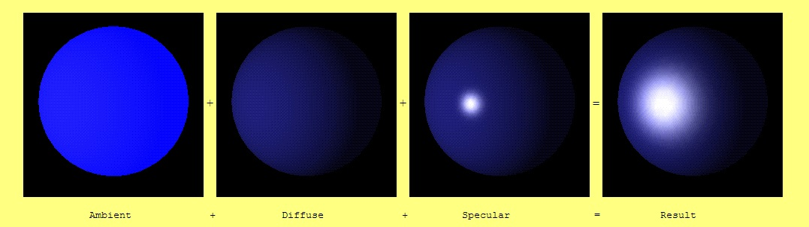
Ambient , Difuse & Specular
Bina Nusantara

Slide 44
Shading
Shading refers to the process of altering a color based on its angle to lights and its distance from lights to create a photorealistic effect. Shading is performed during the rendering process.
There are three popular shading models : flat shading, goraud shading and phong shading.
Bina Nusantara

Slide 45
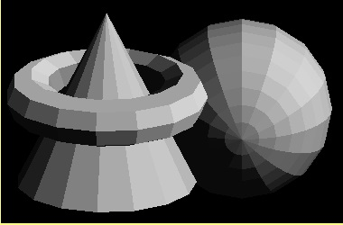
Flat Shading Characteristics
Each entire polygon is drawn with the same colour
Need to know one normal for the entire polygon
Fast
Lighting equation used once per polygon
Bina Nusantara

Slide 46
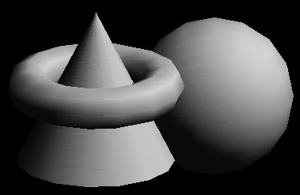
Goraud Shading Characteristics
Colours are interpolated across the polygon
Need to know a normal for each vertex of the polygon
Slower than flat shading
Lighting equation used at each vertex
Bina Nusantara

Slide 47

Phong Shading Characteristics
Normals are interpolated across the polygon
need to know a normal for each vertex of the polygon
better at dealing with highlights than Goraud shading
slower than Goraud shading
lighting equation used at each pixel
Bina Nusantara

Slide 48
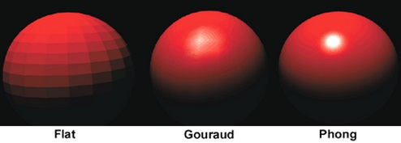
Flat, Gouraud and Phong Shading
Comparison
Bina Nusantara

Slide 49
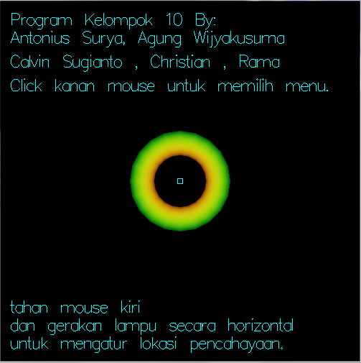
OpenGL Code Result
Home screenshot, right after the launch of the program
Bina Nusantara

Slide 50
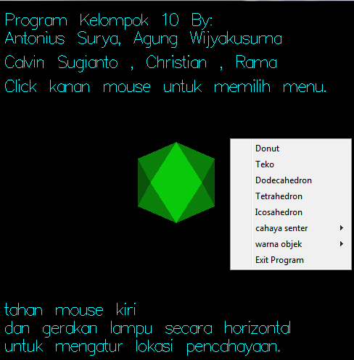
OpenGL Code Result
List of menus in this program
Bina Nusantara

Slide 51
OpenGL Code Result
Donut - this menu is used to change the object shape to donut
Bina Nusantara

Slide 52
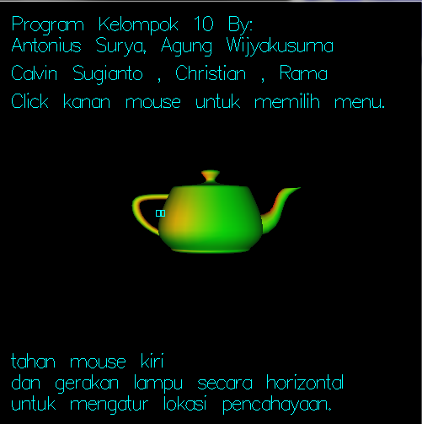
OpenGL Code Result
Teko - this menu is used to change the object shape to a teapot
Bina Nusantara

Slide 53
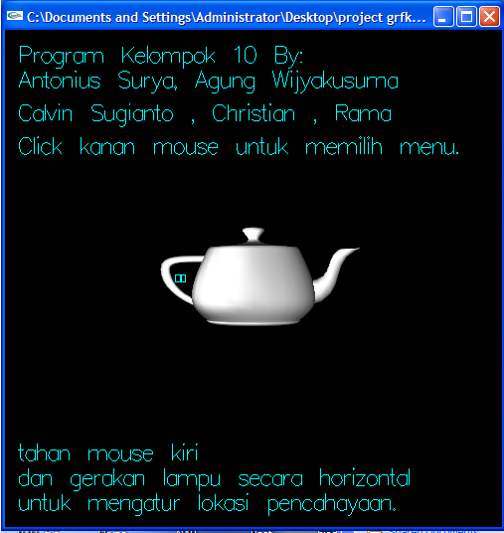
OpenGL Code Result
Teko with white color object and white light color
Bina Nusantara

Slide 54
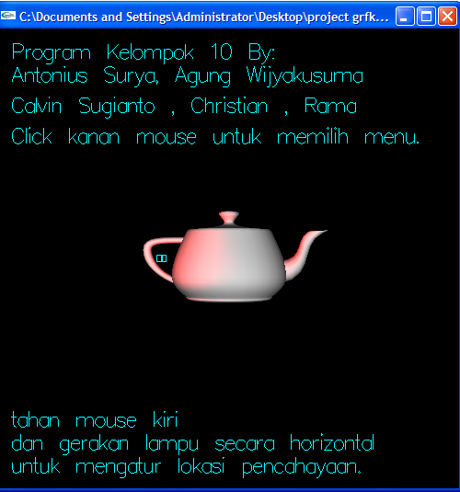
OpenGL Code Result
Teko with white color object and Red light color
Bina Nusantara

Slide 55
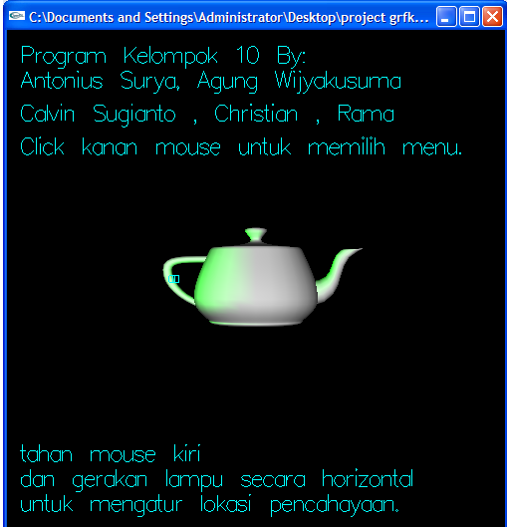
OpenGL Code Result
Teko with white color object and Green light color
Bina Nusantara

Slide 56
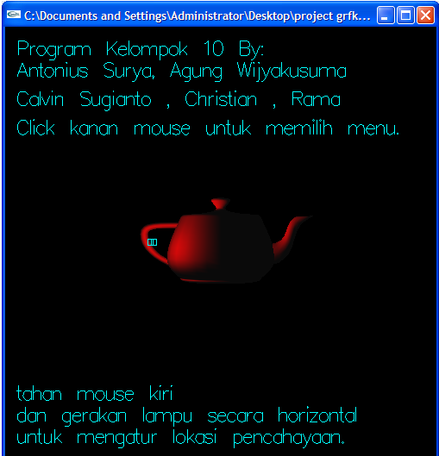
OpenGL Code Result
Teko with disabled color object and Red light color
Bina Nusantara

Slide 57
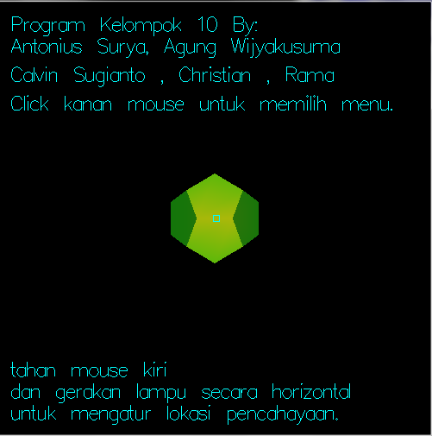
OpenGL Code Result
Dodecahedron - this menu is used to change the object shape to a dodecahedron
Bina Nusantara

Slide 58
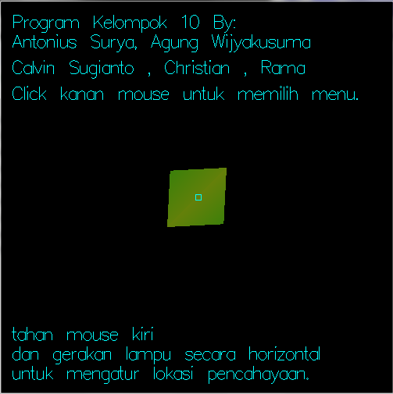
OpenGL Code Result
Tetrahedron - this menu is used to change the object shape to a tetrahedron
Bina Nusantara

Slide 59
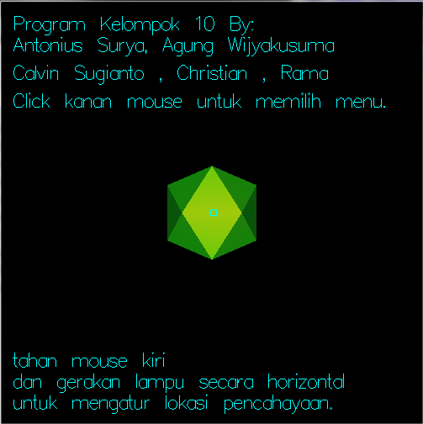
OpenGL Code Result
Icosahedron - this menu is used to change the object shape to a icosahedron
Bina Nusantara

Slide 60
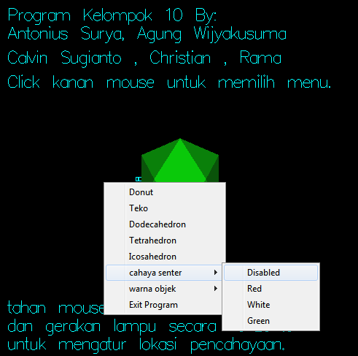
OpenGL Code Result
Cahaya senter - This menu is used to change the lighting color.
The colors selection are disabled (no color), red, white, and green.
Bina Nusantara

Slide 61
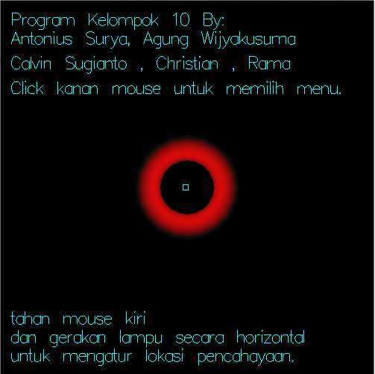
OpenGL Code Result
Cahaya senter - Red
Bina Nusantara

Slide 62
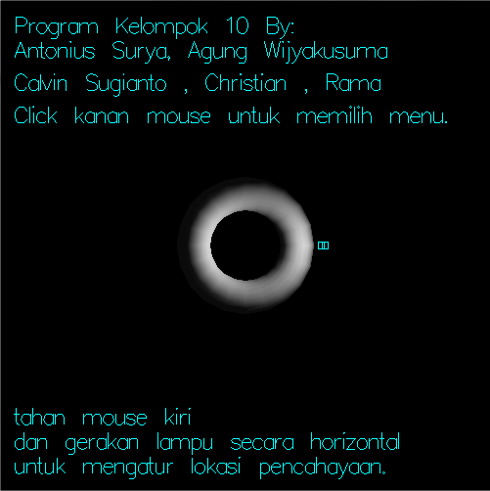
OpenGL Code Result
Cahaya senter - White
Bina Nusantara

Slide 63
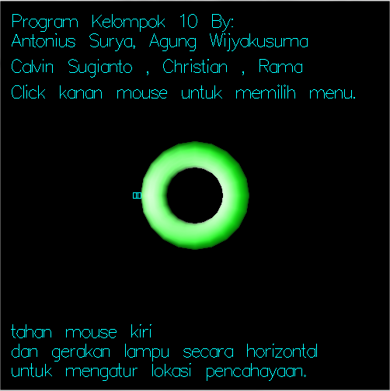
OpenGL Code Result
Cahaya senter - Green
Bina Nusantara

Slide 64
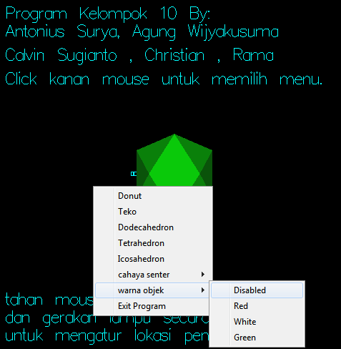
OpenGL Code Result
Warna objek - this menu is used to change the object color. The colors selection are disabled (no color), red, white, and green
Bina Nusantara

Slide 65
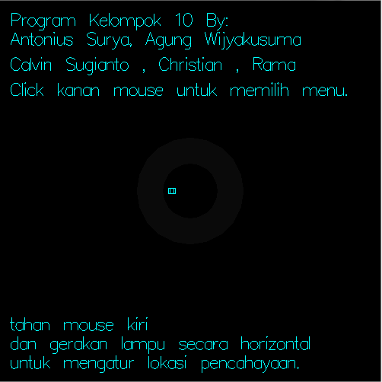
OpenGL Code Result
Warna objek - Disabled
Bina Nusantara

Slide 66
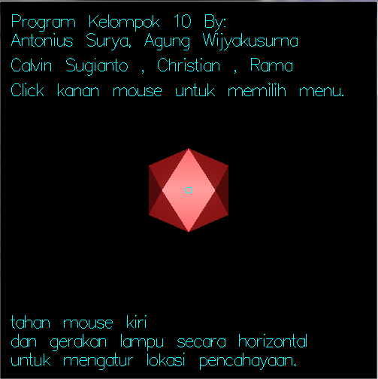
OpenGL Code Result
Warna objek - Red
Bina Nusantara

Slide 67
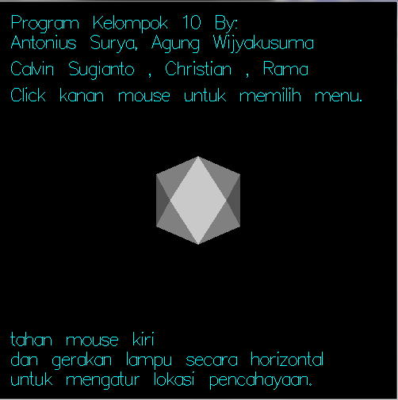
OpenGL Code Result
Warna objek - White
Bina Nusantara

